Slide 1
Introduction to Modern Controls
Relationship Between State-Space Models and Transfer Functions
From State Space to Transfer Functions

Slide 2
Continuous-time LTI state-space description
u (t)
System
_{y(t)}
x₁,x₂,...,xn
^{d} x(t) = Ax(t) + Bu(t)
dt
y(t) = Cx(t) + Du(t)
From State Space to Transfer Functions

Slide 3

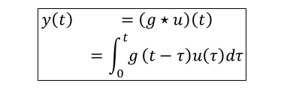
Recap: LTI input/output description
u (t)
System
_{y(t)}
x₁,x₂,...,xn
let u (t) ∈ R and y (t) ∈ R, then
$$\boxed{\begin{matrix}y\left(t\right) & =\left(g⋆u\right)\left(t\right) \\ & =\int_{0}^{t}{g}\left(t−τ\right)u\left(τ\right)dτ\end{matrix}}$$
where g (t) is the system’s impulse response Laplace domain:
Y(s) = G(s)U(s)
$$Y\left(s\right)=ℒ\{y\left(t\right)\},U\left(s\right)=ℒ\{u\left(t\right)\},G\left(s\right)=ℒ\{g\left(t\right)\}$$
From State Space to Transfer Functions

Slide 4

From state space to transfer function
given $A∈ℝ^{n×n}$, $B∈ℝ^{n×1}$, $C∈ℝ^{1×n}$, $D∈ℝ$,
$$\begin{matrix}\frac{d}{dt}x\left(t\right) & =Ax\left(t\right)+Bu\left(t\right) \\ y\left(t\right) & =Cx\left(t\right)+Du\left(t\right)\end{matrix}$$
$$\overset{ℒ}{⇒}$$
$$\begin{matrix}sX\left(s\right)−x\left(0\right) & =AX\left(s\right)+BU\left(s\right) \\ Y\left(s\right) & =CX\left(s\right)+DU\left(s\right)\end{matrix}$$
when $x\left(0\right)=0$, we have
$$\boxed{\frac{Y\left(s\right)}{U\left(s\right)}=C{\left(sI−A\right)}^{−1}B+D≜:G\left(s\right)}$$
–the transfer function between $u$ and $y$
From State Space to Transfer Functions

Slide 5

Analogously for discrete-time systems
for $A∈ℝ^{n×n}$, $B∈ℝ^{n×1}$, $C∈ℝ^{1×n}$, $D∈ℝ$,
$$\begin{matrix}x\left(k+1\right) & =Ax\left(k\right)+Bu\left(k\right) \\ y\left(k\right) & =Cx\left(k\right)+Du\left(k\right)\end{matrix}$$
$$\overset{𝒵}{⇒}$$
$$\begin{matrix}zX\left(z\right)−zx\left(0\right) & =AX\left(z\right)+BU\left(z\right) \\ Y\left(z\right) & =CX\left(z\right)+DU\left(z\right)\end{matrix}$$
when $x\left(0\right)=0$, we have
$$\boxed{\frac{Y\left(z\right)}{U\left(z\right)}=C{\left(zI−A\right)}^{−1}B+D≜:G\left(z\right)}$$
–the transfer function between $u$ and $y$
From State Space to Transfer Functions
5 / 14

Slide 6

From state space to transfer function: Observations
$$\begin{matrix}\frac{d}{dt}x\left(t\right) & =A_{n×n}x\left(t\right)+B_{n×1}u\left(t\right) \\ y\left(t\right) & =C_{1×n}x\left(t\right)+Du\left(t\right)\end{matrix}$$
dimensions:
$$G\left(s\right)= C {\left(SI−A\right)}^{−1} B +D$$
$$1×n n×n n×1$$
$$Σ=\left[\begin{matrix}A_{n×n} & B_{n×1} \\ C_{1×n} & D_{1×1}\end{matrix}\right]$$
uniqueness: $G\left(s\right)$ is unique given the state-space model
From State Space to Transfer Functions

Slide 7

Matrix inverse
$$M^{−1}=\frac{1}{det\left(M\right)}\text{Adj}\left(M\right)$$
where $\text{Adj}\left(M\right)=\{\text{Cofactor} \text{matrix} \text{of} M\}^{T}$
e.g.: $M=\left[\begin{matrix}1 & 2 & 3 \\ 0 & 4 & 5 \\ 1 & 0 & 6\end{matrix}\right]$, $\{\text{Cofactor} \text{matrix} \text{of} M\}=\left[\begin{matrix}c_{11} & c_{12} & c_{13} \\ c_{21} & c_{22} & c_{23} \\ c_{31} & c_{32} & c_{33}\end{matrix}\right]$
where $c_{11}=\left|\begin{matrix}4 & 5 \\ 0 & 6\end{matrix}\right|=24$, $c_{12}=−\left|\begin{matrix}0 & 5 \\ 1 & 6\end{matrix}\right|=5$, $c_{13}=\left|\begin{matrix}0 & 4 \\ 1 & 0\end{matrix}\right|=−4$, $c_{21}=−\left|\begin{matrix}2 & 3 \\ 0 & 6\end{matrix}\right|=−12$, $c_{22}=\left|\begin{matrix}1 & 3 \\ 1 & 6\end{matrix}\right|=3$, $c_{23}=−\left|\begin{matrix}1 & 2 \\ 1 & 0\end{matrix}\right|=2$, $c_{31}=\left|\begin{matrix}2 & 3 \\ 4 & 5\end{matrix}\right|=−2$, $c_{32}=−\left|\begin{matrix}1 & 3 \\ 0 & 5\end{matrix}\right|=−5$, $c_{33}=\left|\begin{matrix}1 & 2 \\ 0 & 4\end{matrix}\right|=4$
From State Space to Transfer Functions

Slide 8
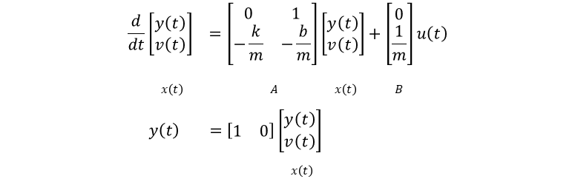
Mass-spring-damper
position: y(t)
k
u = F
b
m
$$\begin{matrix}\frac{d}{dt}\left[\begin{matrix}y\left(t\right) \\ v\left(t\right)\end{matrix}\right] & =\left[\begin{matrix}0 & 1 \\ −\frac{k}{m} & −\frac{b}{m}\end{matrix}\right]\left[\begin{matrix}y\left(t\right) \\ v\left(t\right)\end{matrix}\right]+\left[\begin{matrix}0 \\ \frac{1}{m}\end{matrix}\right]u\left(t\right) \\ & \end{matrix}$$
$$x\left(t\right) A x\left(t\right) B$$
$$y\left(t\right) =\left[\begin{matrix}1 & 0\end{matrix}\right]\left[\begin{matrix}y\left(t\right) \\ v\left(t\right)\end{matrix}\right]$$
$$x\left(t\right)$$
From State Space to Transfer Functions

Slide 9

Mass-spring-damper
$$\begin{matrix}\frac{d}{dt}\left[\begin{matrix}y\left(t\right) \\ v\left(t\right)\end{matrix}\right] & =\left[\begin{matrix}0 & 1 \\ −\frac{k}{m} & −\frac{b}{m}\end{matrix}\right]\left[\begin{matrix}y\left(t\right) \\ v\left(t\right)\end{matrix}\right]+\left[\begin{matrix}0 \\ \frac{1}{m}\end{matrix}\right]u\left(t\right) \\ y\left(t\right) & =\left[\begin{matrix}1 & 0\end{matrix}\right]\left[\begin{matrix}y\left(t\right) \\ v\left(t\right)\end{matrix}\right]\end{matrix}$$
$$\boxed{G\left(s\right)=C{\left(sI−A\right)}^{−1}B+D}$$
$$⇒$$
$$G\left(s\right)=\left[\begin{matrix}1 & 0\end{matrix}\right]{\left[\left[\begin{matrix}s & 0 \\ 0 & s\end{matrix}\right]−\left[\begin{matrix}0 & 1 \\ −\frac{k}{m} & −\frac{b}{m}\end{matrix}\right]\right]}^{−1}\left[\begin{matrix}0 \\ \frac{1}{m}\end{matrix}\right]$$
From State Space to Transfer Functions

Slide 10

Mass-spring-damper
$$\begin{matrix}{\left[\left[\begin{matrix}s & 0 \\ 0 & s\end{matrix}\right]−\left[\begin{matrix}0 & 1 \\ −\frac{k}{m} & −\frac{b}{m}\end{matrix}\right]\right]}^{−1} & ={\left[\begin{matrix}s & −1 \\ \frac{k}{m} & s+\frac{b}{m}\end{matrix}\right]}^{−1} \\ & =\frac{1}{s^{2}+\frac{b}{m}s+\frac{k}{m}}\left[\begin{matrix}s+\frac{b}{m} & 1 \\ −\frac{k}{m} & s\end{matrix}\right]\end{matrix}$$
From State Space to Transfer Functions

Slide 11
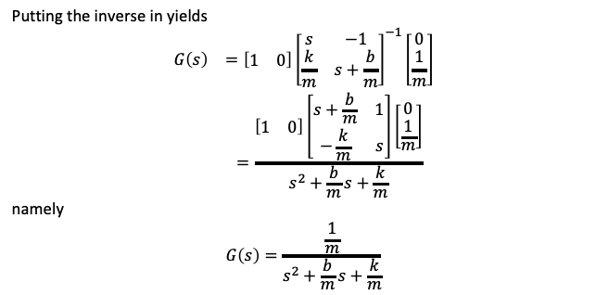
Mass-spring-damper
Putting the inverse in yields
$$\begin{matrix}G\left(s\right) & =\left[\begin{matrix}1 & 0\end{matrix}\right]{\left[\begin{matrix}s & −1 \\ \frac{k}{m} & s+\frac{b}{m}\end{matrix}\right]}^{−1}\left[\begin{matrix}0 \\ \frac{1}{m}\end{matrix}\right] \\ & =\frac{\left[\begin{matrix}1 & 0\end{matrix}\right]\left[\begin{matrix}s+\frac{b}{m} & 1 \\ −\frac{k}{m} & s\end{matrix}\right]\left[\begin{matrix}0 \\ \frac{1}{m}\end{matrix}\right]}{s^{2}+\frac{b}{m}s+\frac{k}{m}}\end{matrix}$$
namely
$$G\left(s\right)=\frac{\frac{1}{m}}{s^{2}+\frac{b}{m}s+\frac{k}{m}}$$
From State Space to Transfer Functions

Slide 12
Numerical example in MATLAB
position: y(t)
k
u = F
b
m
m = 1; k = 2; b = 1;
A = [0 1; -k/m -b/m];
B = [0; 1/m];
C = [1 0];
D = 0;
sys = ss(A,B,C,D)
[num,den] = ss2tf(A,B,C,D); sys_tf = tf(num,den) figure, step(sys)
figure, step(sys_tf)
From State Space to Transfer Functions

Slide 13
Numerical example in Python
import control as co import numpy as np
m = 1
k = 2
b = 1
A = np.array([[0,1],[-k/m,-b/m]])
B = np.array([[0], [1/m]])
C = np.array([1,0])
D = np.array([0])
sys = co.ss(A,B,C,D) print(sys)
sys_tf = co.ss2tf(sys) print(sys_tf)
print(co.poles(sys)) print(co.poles(sys_tf))
From State Space to Transfer Functions

Slide 14

Exercise
Given the following state-space system parameters: $A=\left[\begin{matrix}0 & −6 & 0 \\ −2 & 1 & 0 \\ 0 & 0 & −1\end{matrix}\right]$, $B=\left[\begin{matrix}−6 & 0 & −3 \\ −2 & 1 & 0 \\ 0 & 2 & 3\end{matrix}\right]$, $C=\left[\begin{matrix}0 & 1 & 0 \\ 0 & 0 & 1\end{matrix}\right]$, $D=\left[\begin{matrix}1 & 0 & 0 \\ 0 & 0 & −1\end{matrix}\right]$, obtain the transfer function $G\left(s\right)$.
From State Space to Transfer Functions

